Slide 1
Advanced Placement Parent Information
John Marshall Campus

Slide 2
AP at John Marshall
John Marshall students have access to AP courses throughout High School. Students are placed in AP courses for the following reasons:
Teacher Recommendation
Historical Scores and Grades
Student Choice and Self-enrollment

Slide 3
AP Courses at John Marshall
Science | English | Computer Science | Math
AP Environmental Science | AP Language and Composition | AP Computer Science Principles | AP Statistics
AP Biology | AP Literature | AP Computer Science A | AP Calculus AB
AP Physics |  |  | AP Calculus BC

Slide 4
What are the benefits of taking AP?
Research consistently shows that AP students are better prepared for college than students who don’t take AP. They’re more likely to enroll and stay in college, do well in their classes, and graduate in four years.
Our AP Courses prepare our students for the challenge they face in College while they still get support from HS
Students can earn College Credit

Slide 5
How can my child earn college credit with AP?
More colleges than ever before have credit policies that grant college credit and/or placement for students’ AP scores. This will help your child save money on tuition as well as skip introductory courses.
To see how AP Exam scores are accepted at colleges across the country, use the AP Credit Policy Search.

Slide 6
National Math and Science Initiative
This is a Grant Award and Special Designation John Marshall has received.
AP Students receive study resources aligned to their AP class
AP Teachers receive funding for equipment and additional training to make sure every student is successful in our AP Courses

Slide 7
Parent Resource: Understanding AP
COLLEGE BOARD September 21, 2020
https://blog.collegeboard.org/parent-resource-understanding-ap

Slide 8
What is AP Classroom?
Topic Questions—Students can answer the Topic Questions after each class lesson to check their skills and get immediate feedback on where to focus their time and attention.
Personal Progress Checks—Students can complete the Personal Progress Check at the end of each unit to see if they’re on track. They can then use their results to customize a study plan just for them.
Progress Dashboard—By opening the Progress Dashboard, students can see how their skills are developing across units. They should celebrate their successes and then focus on the skills that need their attention.
https://myap.collegeboard.org/login

Slide 9
AP Daily from College Board
These short videos are recorded by AP teachers across the country and will cover every topic in every unit to help students stay on track with their coursework. All videos are mobile friendly and can be watched on any device that has internet access so students can learn anytime, anywhere.

Slide 10
AP Teachers
AP Environmental Science
Ilona Jurewicz – Ilona.jurewicz@clevelandmetroschools.org
AP Biology
Victoria Fleming – Victoria.fleming@clevelandmetroschools.org
AP Physics
Olga Spence –
Olga.spence@clevelandmetroschools.org
AP Language & Composition
Kim Greytak – Kimberly.greytak@clevelandmetroschools.org
AP Literature
Kate Sergeant – Kathryn.sergent@clevelandmetroschools.org
AP Computer Science Principles
Briana Chapek – briana.Guevara@clevelandmetroschools.org
AP Computer Science A
Arley Trujillo – arley.Trujillo@clevelandmetroschools.org

Slide 11
AP Support Staff
Chelsey Cook Kohn – AP Admin
John Marshall IT Principal
Chelsey.cook@clevelandmetroschools.org
Joseph Ciesielski – AP Admin
John Marshall Civic & Business Leadership Assistant Principal
Joseph.Ciesielski@clevelandmetroschools.org
Wendy Forrey – AP Counselor
John Marshall IT Counselor
Wendy.forrey@clevelandmetroschools.org
Tamie Carlisle – AP Testing Coordinator
John Marshall Civic & Business Leadership Teacher
Tamie.Carlisle@clevelandmetroschools.org

Slide 12
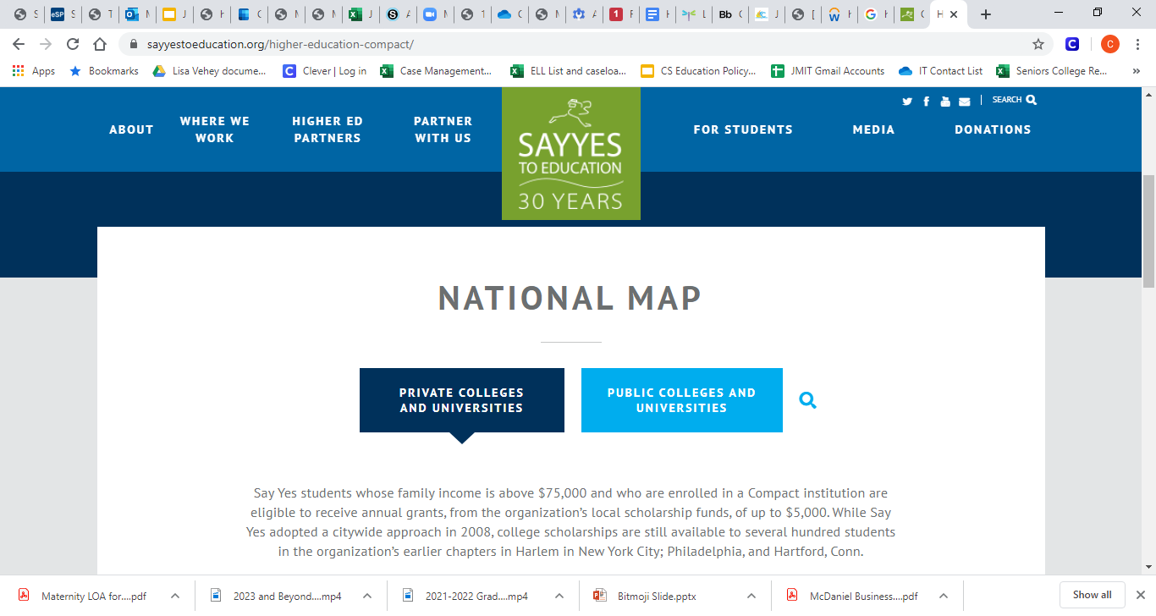
Say Yes Schools to Explore
OHIO PUBLIC COLLEGES AND UNIVERSITIES, AND TECHNICAL CENTERS
https://sayyescleveland.org/scholarships/ohio-public-colleges-and-universities/
National Map of Say Yes Schools
https://sayyestoeducation.org/higher-education-compact/

